Slide 1
Notification List
Asad Valliani
and
Joe Le

Slide 2
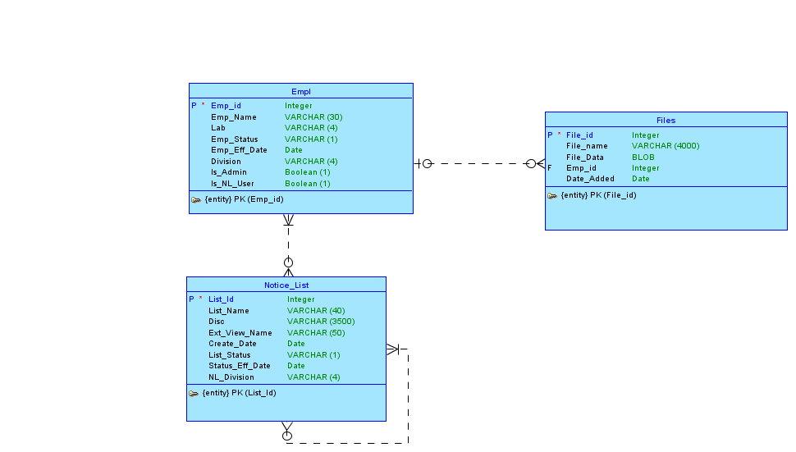
Conceptual Model

Slide 3
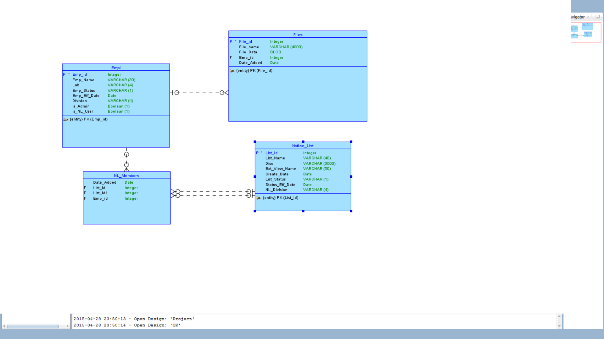
Logical Model

Slide 4
Application
We implemented the must haves and 2 good to haves
Theme Roller
3D Chart

